Slide 1
ECONOMIC Theorizing, Economic Relationship and Economic tool to handle data

Slide 2
ECONOMIC THEORIZING

Slide 3
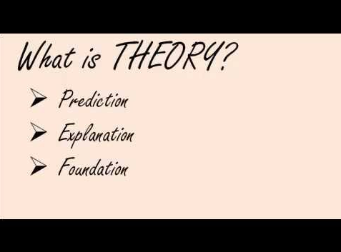

Slide 4


Slide 5
ECONOMIC THEORIZING
Economic theorizing begins with economists' considerations of the main features of a certain class of phenomena. These considerations are then formulated into theoretical models. Economic laws are derived from these models and are then used to explain the class of phenomena in question.
Its purpose is to analyze and explain the behavior of the various economic elements.

Slide 6
ECONOMIC RELATIONSHIP

Slide 7


Slide 8
MEANING
Economic Relationship means any financial dealing, business relationship or client representation.
Here's a list of five key economic relationships for a business owner or policymaker to remember when making decisions:
Price Up, Demand Down.
Price Up, Supply Up.
Interest Rates Up, Investment Up.
Money Supply Up, Interest Rates Down.
Economic Growth Up, Unemployment Down.

Slide 9
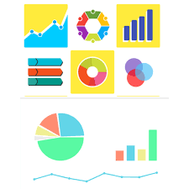
Economic tool to handle data

Slide 10
Economic tools (or tools of economic analysis) facilitate the preparation of a robust decision.
An economic assessment basically deals with the following: benefits and costs, usually measured in monetary terms.
Economists use many tools to test their models, including case studies, lab-based experimental studies, and statistics.

Slide 11
Basic Tools in Economic Analysis
VARIABLES.(The measurable variables in economics are quantity, quality and distribution.)
CETERIS PARIBUS.(This commonly-used phrase stands for 'all other things being unchanged or constant’.)
FUNCTION.(Function means the dependent variable is determined by the independent variable(s).)
EQUATIONS.(An equation is made up of two expressions connected by an equal sign. )
IDENTITIES. (the idea that people make economic choices.)
GRAPHS AND DIAGRAMS.(They show the relationship between two variables in economics.)

Slide 12
Summary
An economic theory is a set of concepts and principles that define how various economies work.
Economic relations are one fundamental key for understanding the workings of an economy.
As more and more data is generated and collected, data analysis requires scalable, flexible, and high performing tools to provide insights in a timely fashion.
In conclusion, all economic systems are designed to manage the production, consumption, and distribution of goods and services.

